Slide 1
Introductory General Chemistry
Chemistry 3A
Experiment 6a
Molecular Modeling
Mitch Halloran

Slide 2
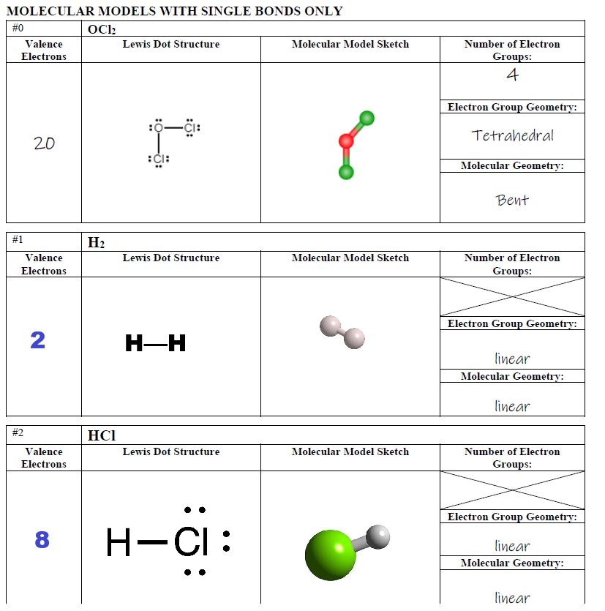

Slide 3
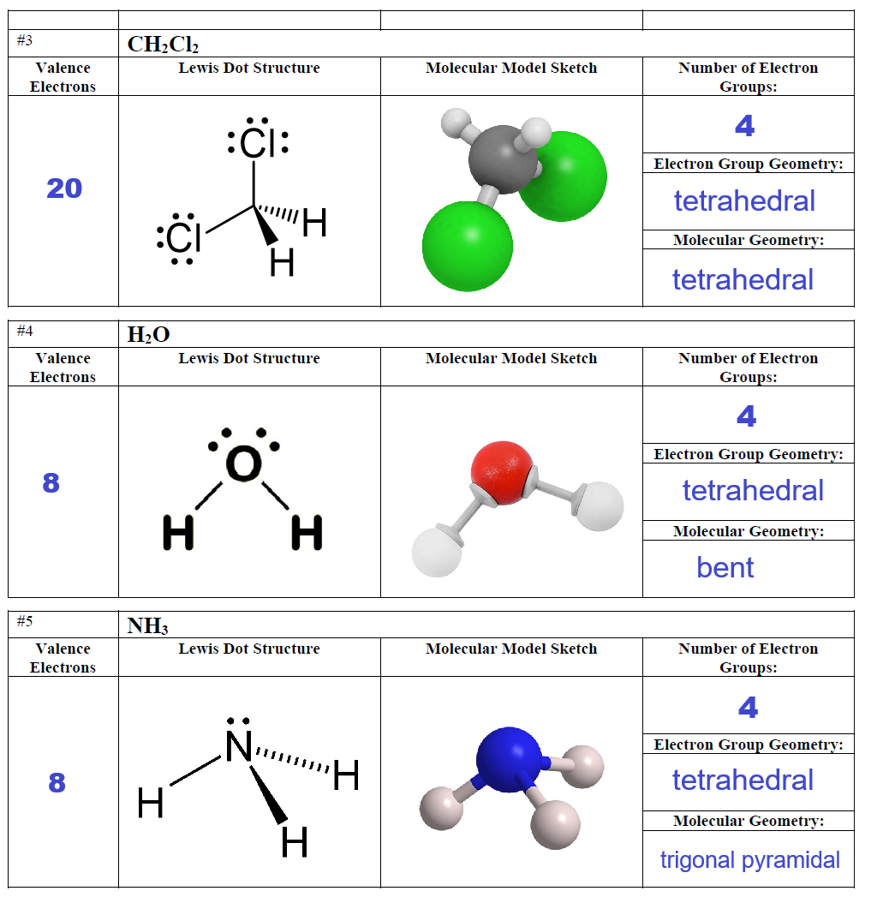

Slide 4
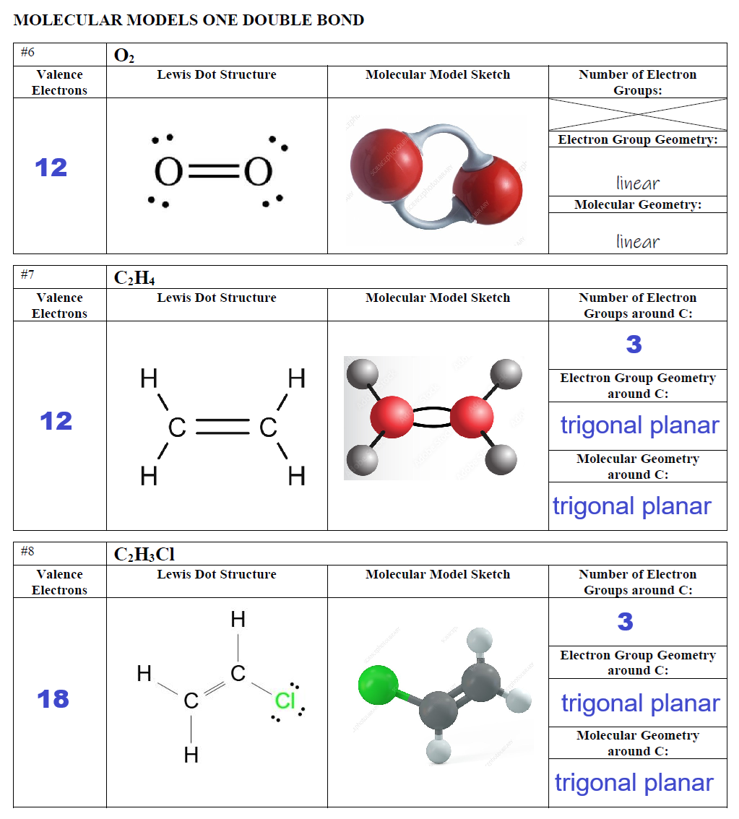

Slide 5
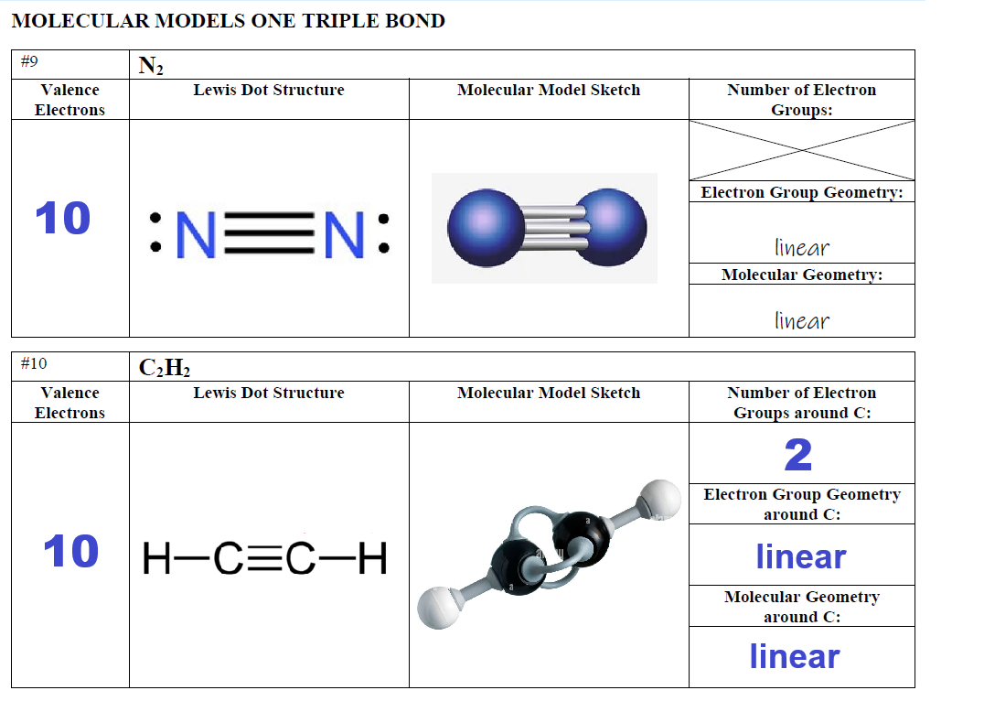

Slide 6
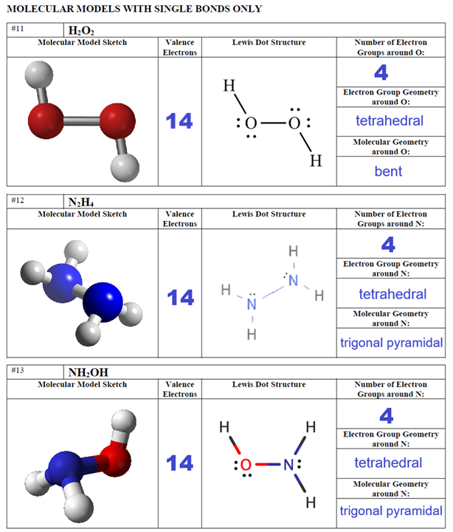

Slide 7
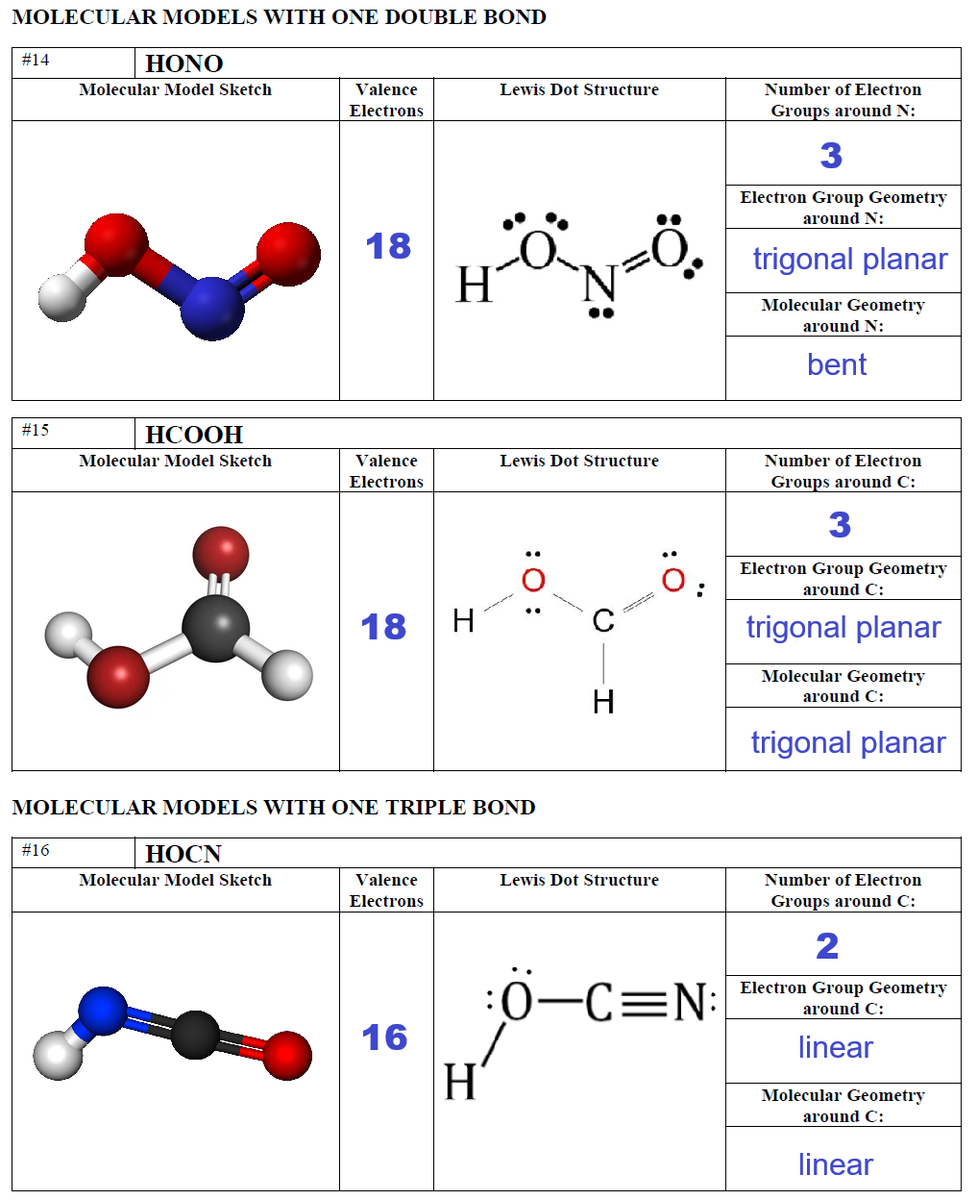

Slide 8
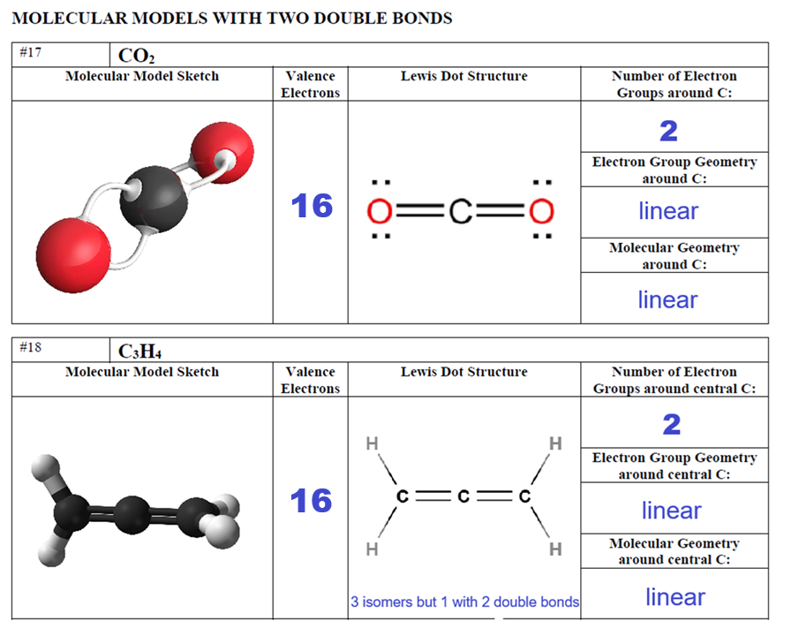

Slide 9


